Slide 1
PROJECT 2
MOVIE RECOMMENDER SYSTEM
Lara Clasen
Bellevue University
Spring 2020 Term
Notes:
This is a presentation of my data analysis project to build a movie recommender system.

Slide 2


PROJECT DETAILS
Notes:
The enclosed data analysis project aims to build a recommendation system for movie choices using R programming language. Recommendation systems are algorithms that work to offer relevant suggestions to the user based on a particular industry or product area. The resulting recommendation for this project system falls into the category of item-to-item, or item-based, collaborative filtering. It will allow users to obtain accurate recommendations for movie choices without the requirement of doing anything but looking at their phone or using the app which utilizes such an algorithm.

Slide 3


PROJECT DETAILS
Notes:
The data source is a research group out of the University of Minnesota called GroupLens. This group specializes in recommender systems and other online computing systems and researches their use and abilities. The original data comes from MovieLens, a research site run by GroupLens, which uses collaborative filtering technology to make movie recommendations.

Slide 4
Why is this important?
Option
Option
Option
Option
Option
Option
Option
Option
Notes:
This type of system is important and becoming more important every day. Users are met with an incredible number of options for everything from dining choices to entertainment choices in our modern world where the internet prevails. Ratings and reviews are one of the most common ways that consumers find and try new things, and with a recommender system put in place, applications are able to offer valuable suggestions to their customers.

Slide 5



Why is this important?
Notes:
Recommender systems are all around us in today’s world. A few examples of programs that utilize these systems are Spotify, Netflix, and YouTube.
Spotify uses its algorithms to create personalized playlists for its users. These are curated based on each user’s liked songs, shares, saves and skips, combined with the behaviors of users with similar listening habits.
If you are a Netflix user, you know that you have the ability to rate movies with a thumbs up or down. The recommendation algorithm considers several factors such as available genres, user streaming and rating history, and combined ratings of all Netflix users with similar tastes. This is how Netflix determines the percent match it portrays on each video.
The more you use the app and rate movies, the better the suggestions become.
YouTube is one of the most visited website in the United States year after year, making a good case for their use of recommender systems. YouTube uses a twofold approach to making recommendations to visitors. A recommendation generator takes activity history and makes broad suggestions, and then a ranking network does some more precise work by scoring those recommendations before presenting them to the user.

Slide 6
Recommender systems
1
Content-based
2
Collaborative filtering
Notes:
There are a few different types of recommendation systems that can be used for this sort of data. A simple recommender is pretty basic and offer suggestions based on what the general public “likes”. However, to get a bit deeper we can build either a content-based or collaborative filtering recommendation system for this movie data. Both of these use the specific user’s behavior to make suggestions. While content-based recommenders base their suggestions directly on user preferences for product features, collaborative filtering (as the name suggests) makes assumptions based on the user’s preferences as they relate to other user preferences. Because we have quite a bit of “content” to work with in this data set, we should be able to build either type of algorithm, but I will focus on building a collaborative filtering algorithm.

Slide 7
ABOUT THE DATA
Notes:
In the next slides we will review the data set and look at various ways to become familiar with it.

Slide 8
ABOUT THE DATA
105,339 ratings
6,138 tags
10,329 movies
movie_data.csv | rating_data.csv
Notes:
The data set I have used contains rating and tagging activities from MovieLens and consists of 105,339 ratings and 6,138 tagging applications across 10,329 movies. Users are represented simply by an ID without any other demographic detail. All users had rated at least 20 movies to be selected. To begin, we retrieve our data from two distinct CSV files and translate them into dataframes. The two files we will be working from are named movie_data.csv and rating_data.csv, containing movie-specific data and rating-specific data, respectively.

Slide 9
ABOUT THE DATA
 | userID | movieID | rating
Minimum | 1.0 | 1 | 0.500
1st Qu. | 192.0 | 1073 | 3.000
Median | 383.0 | 2497 | 3.500
Mean | 364.9 | 13381 | 3.517
3rd Qu. | 557.0 | 5991 | 4.000
Maximum | 668.0 | 149532 | 5.000
summary(rating_data)
head(rating_data)
userID | movieID | Rating
1 | 16 | 4.0
1 | 24 | 1.5
1 | 32 | 4.0
1 | 47 | 4.0
1 | 50 | 4.0
1 | 110 | 4.0
Notes:
One of the first ways we can become familiar with our data is by running the head and summary functions for both movie_data and rating_data. The summary function gives us an overview of our dataframes while the head function provides the first 6 rows of each data set. Looking at our summary of the rating_data dataframe, we can see a few interesting characteristics. We see that the minimum user rating is .5 and the maximum is 5. This is to be expected considering ratings go from 0 to 5 in .5 increments. The mean rating is 3.517. We can also see that we likely have 668 users based on the minimum and maximum user IDs.

Slide 10
ABOUT THE DATA
head(movie_data)
movieID | title | genres
1 | Toy Story | Adventure|Animation|Children|Comedy|Fantasy
2 | Jumanji | Adventure|Children|Fantasy
3 | Grumpier Old Men | Comedy|Romance
4 | Waiting to Exhale | Comedy|Drama|Romance
5 | Father of the Bride II | Comedy
6 | Heat | Action|Crime|Thriller
movieID | title | Adventure | Animation | Children | Comedy
1 | Toy Story | 1 | 1 | 1 | 1
2 | Jumanji | 1 | 0 | 1 | 0
3 | Grumpier Old Men | 0 | 0 | 0 | 1
one-hot encoding:
Notes:
By looking at the first few rows of our movie_data dataframe, we can see that we need to adjust the genre feature so that it is in a more workable format. To do this, we use one-hot encoding to create a matrix consisting of genres for each film. With one-hot encoding, the categorical encoded variable is removed and a new binary variable is added for each unique category value.

Slide 11
DATA
PREPARATION
STEPS
Notes:
There is some data preparation that we will need to perform in order to have the best data set to work with. First, we will apply some pre-processing procedures. Then, our data preparation steps will include selecting useful data, normalizing data, and binarizing the data.

Slide 12
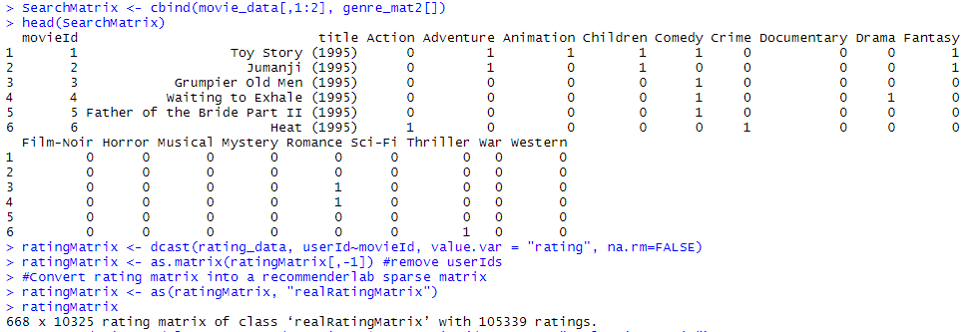
PREPROCESSING
Notes:
To begin pre-processing our data, we want to create a search matrix to allow us to easily search the films by specifying the genre feature. We do this using the cbind function in R which involves merging two data frames, with an equivalent number of rows, together into a single data frame. A majority of the movies connect with more than one genre. For example, Jumanji associates with the genres Adventure, Children, and Fantasy. In order to make sense of the movie ratings, we must convert our matrix into a sparse matrix. This new matrix is of the class 'realRatingMatrix'.

Slide 13

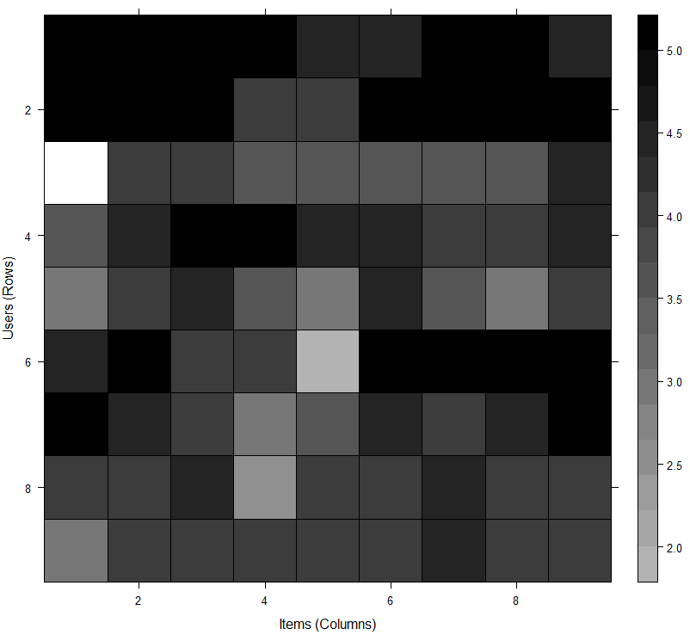
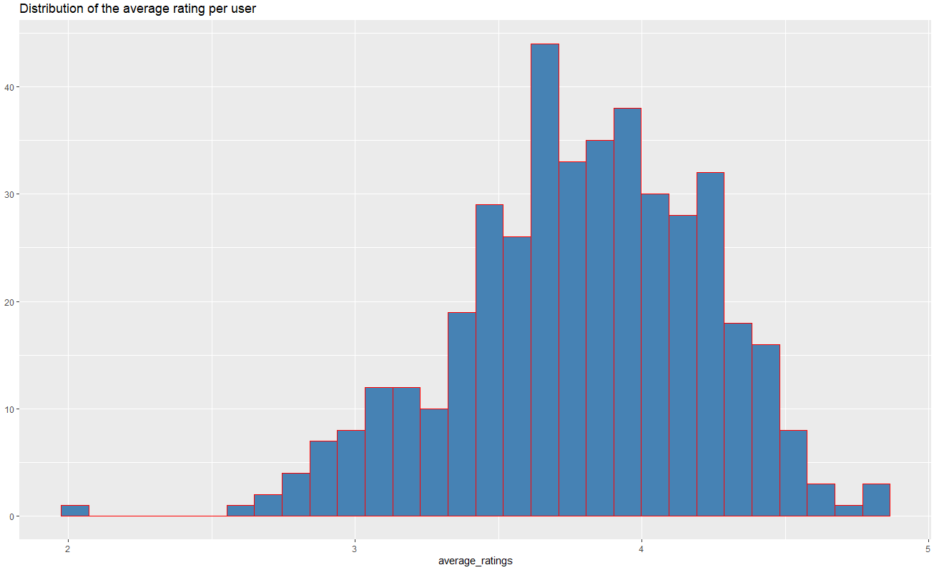
DATA PREPARATION
Heatmap of top users and movies
Distribution of the average rating per user
Notes:
To limit our data to more valuable points we will set a threshold such that a movie must have been rated by a min of 50 users and have a minimum of 50 views. This way, we have filtered a list of watched films from the least watched ones. After implementing this threshold, we now have 420 users and 447 films compared to the previous 668 users and 10,325 films. We can now delineate our matrix of relevant users. We produce a heat map of our top users and top movies. We also create a chart displaying the distribution of the average ratings per user. This visualization reflects our understanding that a user is more likely to rate a movie between 3.5 and 4 than any other rating available.

Slide 14
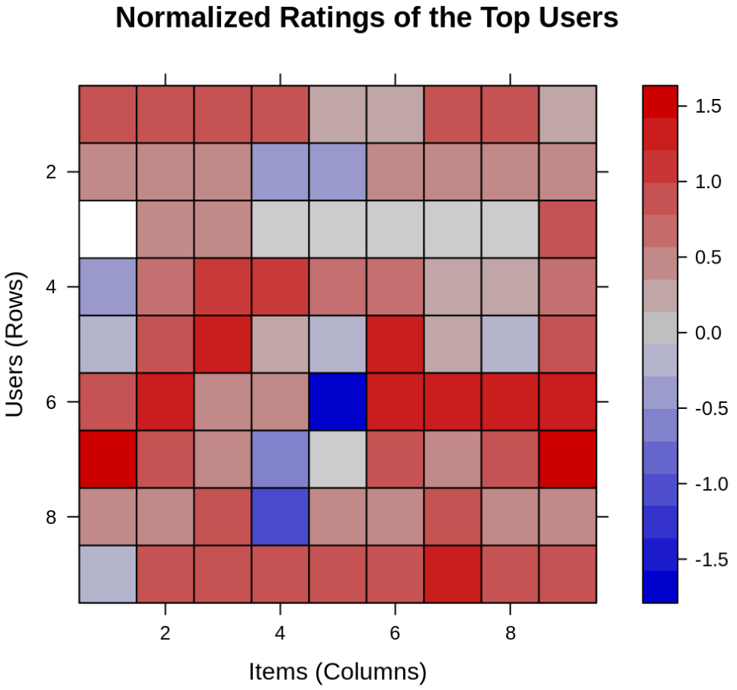
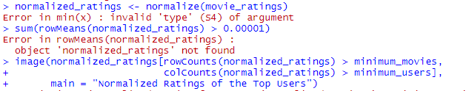
DATA PREPARATION
Normalized ratings of the top users
Notes:
In the next step of data preparation, we want to normalize our data. For some of our users they may have consistently rated all movies either very high or very low. This can create a strong bias within our data set, and so it is something that we want to work through a bit before proceeding. To remove this bias, we standardize the numerical values for a feature to a common scale value. The reduces the distortion in the range of our values. By normalizing we achieve an average value across all ratings of 0. We can then create a heat map displaying our now normalized rating feature.

Slide 15
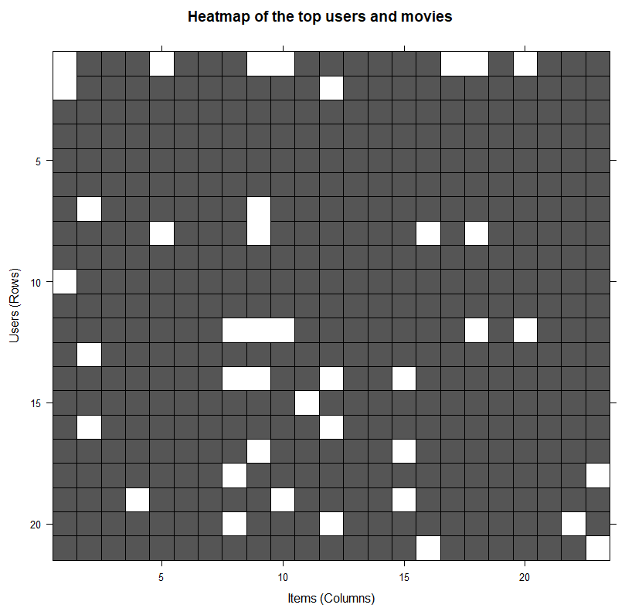
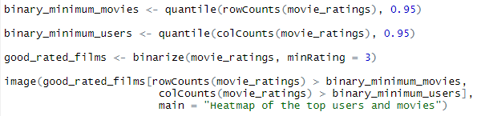
DATA PREPARATION
Heatmap of the top users and movies
Notes:
Finally, we can bin our data to simplify the process and allow our recommendation system to work more efficiently. Binarization is used when you want to convert a numerical feature vector into a Boolean vector, or binary representation. Binarizing means that we will end up with two discrete values: 0 and 1. We will define a matrix that will consist of 1 if the rating is above 3 and 0 if the rating is below 3.

Slide 16
BUILD A
RECOMMENDER
SYSTEM
Notes:
From here we are able to move forward and build our recommender system.

Slide 17
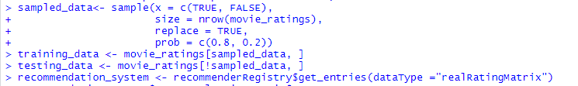
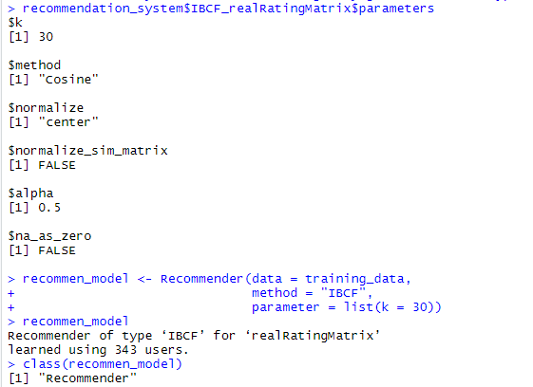
RECOMMENDER SYSTEM
Notes:
We can now begin to develop our recommender system using item based collaborative filtering. This method finds similarity between items based on user ratings of those items. The algorithm builds a table of similarity which is then fed into the system. To build this algorithm we must first split the data set into a test and train set split by 80/20. In the first step the algorithm identifies the k most similar items and store their number. Here, k is equal to 30. We use the Cosine method, which is the default method, but we could have also used the Pearson method.

Slide 18
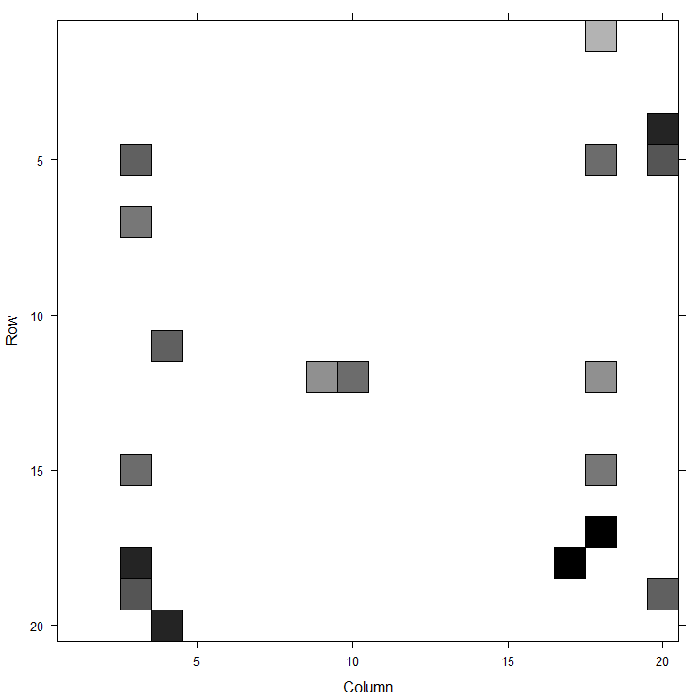
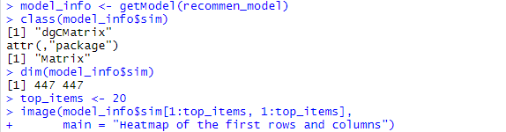
RECOMMENDER SYSTEM
Heatmap of first rows and columns
Notes:
Now that we have defined our model, using the getModel() function we can retrieve the model in the next step. Then we will find the class and dimensions of our similarity matrix. We can generate a heat map from this step containing the top 20 items and visualize the similarities between them.

Slide 19
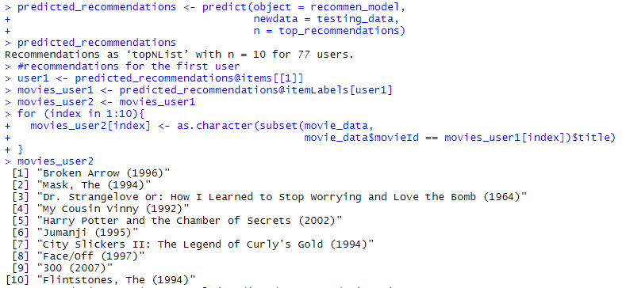
RECOMMENDER SYSTEM
Notes:
Next, we will create a new variable to consist of our top recommendations. We will then use the predict() function to identify items that are similar and rank them appropriately.

Slide 20
IN
SUMMARY
Notes:
Recommendation systems are incredibly common machine learning methods, improving upon traditional classification algorithms with the ability to make accurate predictions based on user behavior. We have been able to successfully build a recommendation system to predict and recommend movie choices to users. This model provides suggestions to users through a filtering system based on user preferences and historical behavior, finding similarities between different products or, in our case, movies. The input is collaborative user information and the output is the resulting recommendation.

